Slide 1
SS855 Research Methodology in Applied Science
CORRELATION AND REGRESSION
Submitted to
Dr Smitha Chandran S
Assi. Professor
Department of Chemistry
Presented by
KUMARI S SARANYA
AM.PS.R4PHY24006
Department of Physics

Slide 2
CORRELATION
The extent (degree) of the linear relationship between two variables is called correlation
It is a statistical tool that measures the closeness or strength of the relationship between the variable
Correlation analysis is not only establishing relationship but also quantify it.
Correlation is unable to indicate the cause and effect relationship between two variables.

Slide 3
Types of Correlation
I .Positive and negative correlation
Simple , Partial and multiple correlation
Linear and non-linear correlation

Slide 4
I. Positive and Negative correlation
Positive correlation
Negative correlation
Y
Y
X
X
In this an increase or decrease in the value of one variable is associated with the increase or decrease in the value of the other
In this increase in one variable causes the proportionate decrease in the other variable

Slide 5
II Simple ,Partial and Multiple correlation
Simple correlation –In this only two variable are involved, and these two variables are taken in to consideration at a time.
eg: yield of wheat and the amount (dose )of fertilizers
Partial correlation-*Relationship between three or more variables is studied.*In this type only two variables are into consideration and other variables are excluded.
eg: yield of wheat and the amount of fertilizers are taken into consideration and the effect of other variables such as effect of pesticides ,type of soil ,availability of water etc are not taken in to consideration.
Multiple correlation- *In this three or more variables are studied simultaneously.*However multiple correlation consist of measurements of relationships between a dependable variable and two or more independent variable . eg: relation between agricultural production ,rainfall and quantity of fertilizers used.

Slide 6
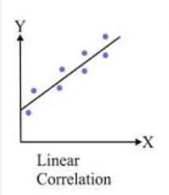
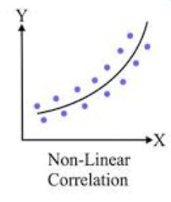
III Linear and Non linear correlation
Values have constant ratio
X=10,20,30,40
Y=20,40,60,80
X values doubled then Y also doubled
Values does not have constant ratio
eg: If the fertilizer is doubled yield of wheat crop would not be exactly doubled.

Slide 7
Measures of correlation
1.Scatter diagram
2.Graph method
3.Correlation coefficient

Slide 8
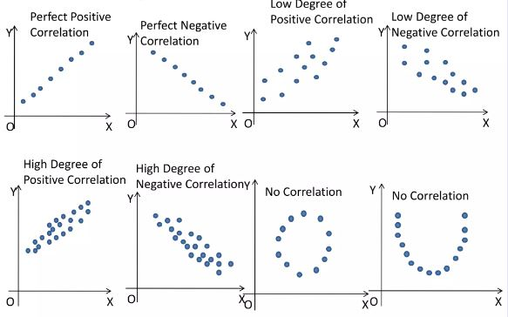
1.Scatter diagram

Slide 9
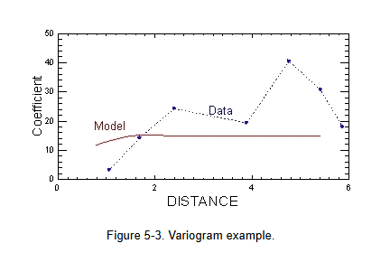
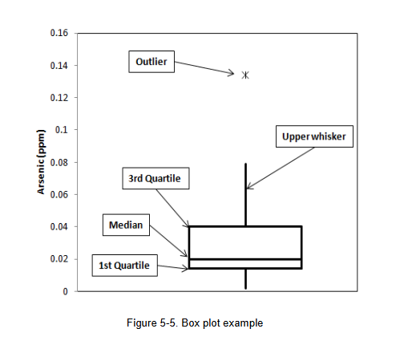
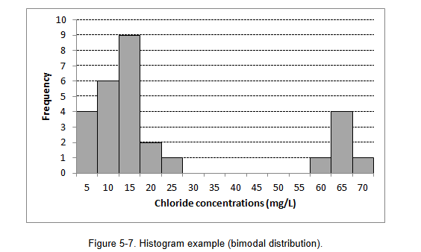
2. Graph method

Slide 10
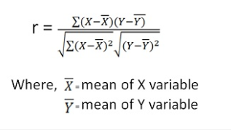
3.Correlation Coefficient
Scatter diagram and graphic method only gives a rough idea about the relationship between two variables but does not give numerical measure of correlation.
The degree of relationship can be established by calculating the correlation coefficient which is denoted by r.
Definition: The coefficient of correlation r can be defined as the measure of strength of the linear relationship between the two variables X and Y
Karl Pearson’s coefficient of correlation
r=1 Perfect positive relationship
r=-1Perfect negative relationship
r=0 Non relationship

Slide 11
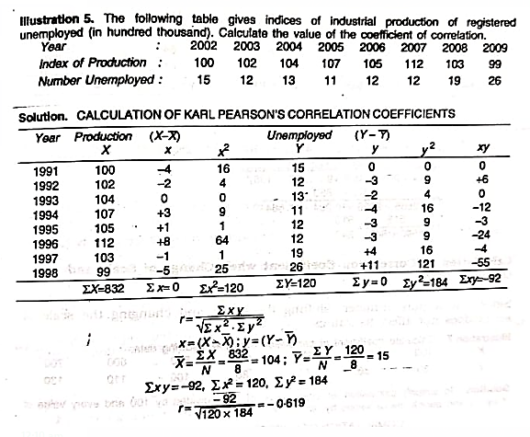
Problem 1
Refer text of SS Gupta page 389

Slide 12
Regression analysis
Regression analysis measures the nature and extent of the relationship between two or more variables , thus enables us to make predictions.
Regression is the measure of the average relationship between two or more variables.

Slide 13
Comparison between Correlation and Regression
Correlation | Regression
Correlation is a measure of degree of relationship between X and Y | Studies the nature of relationship between the variables so that one may be able to predict the value of one variable on the basis of another.
Does not always assume cause and effect relationship between two variables. | Clearly express the cause and effect relationship between two variables. The independent variable is cause and dependent variable is effect
Correlation doesn't help in making predictions | Regression enable us to make predictions using regression line
Independent of the change of origin and scale | Independent of change of origin but not of scale

Slide 14
Regression lines
The regression line shows the average relationship between two variables .It is also called line of Best Fit.
If two variables X and Y are given ,then there are two regression lines
1.Regression line of X on Y
2.Regression line of Y on X
Nature of regression line
If r=± 1 then the regression lines are coincide
If r=0 then the two regression lines intersect each other at 90˚

Slide 15
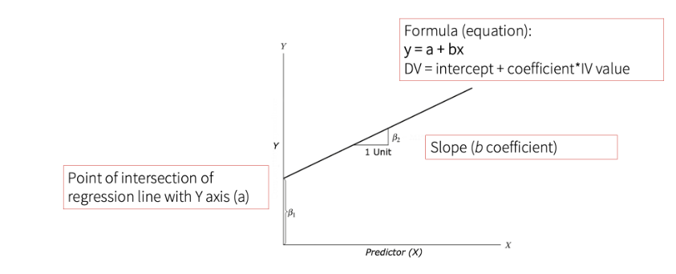
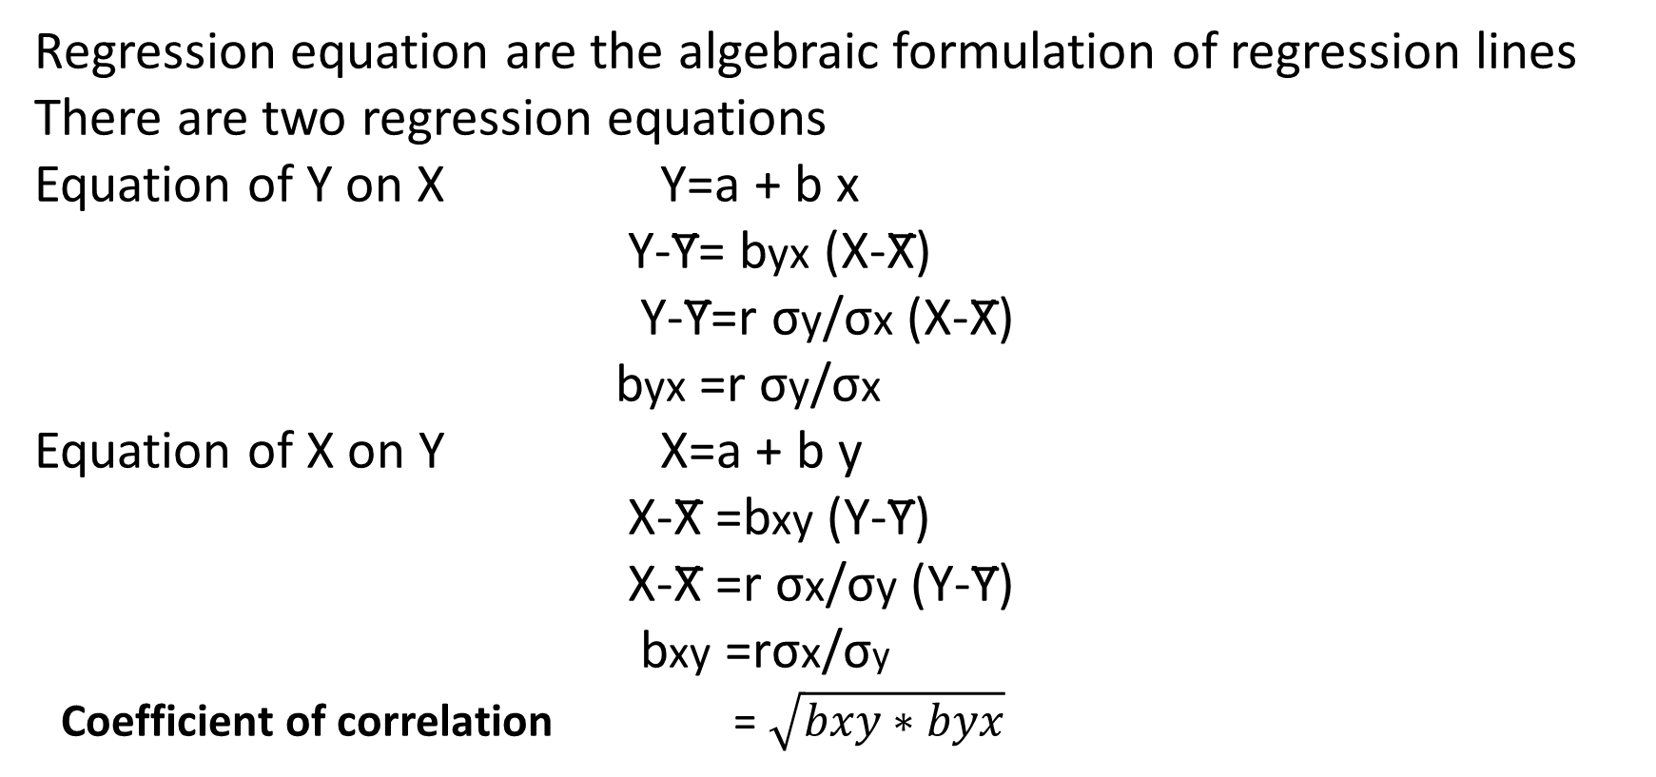
Regression equations
Regression equation are the algebraic formulation of regression lines
There are two regression equations
Equation of Y on X Y=a + b x
Y-Y̅= byx (X-X̅)
Y-Y̅=r σy/σx (X-X̅)
byx =r σy/σx
Equation of X on Y X=a + b y
X-X̅ =bxy (Y-Y̅)
X-X̅ =r σx/σy (Y-Y̅)
bxy =rσx/σy
Coefficient of correlation = $\sqrt{bxy∗byx}$

Slide 16
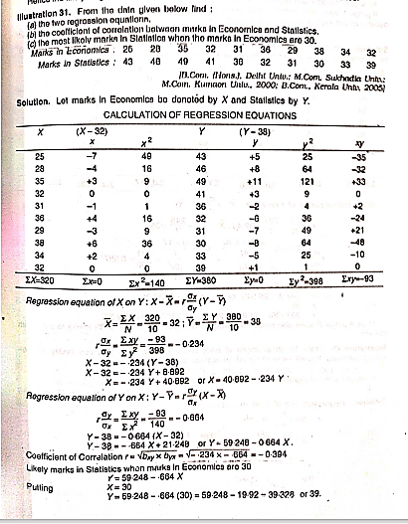

Slide 17
References
CR Kothari :Research Methodology Methods and Techniques
SS Gupta : Statistical Methods

Slide 18


